Slide 1
Microsoft Power BI

Slide 2
Report Authoring and Customization with Power BI Embedding
Ted Pattison
Principal Program Manager
Power BI Customer Advisory Team (PBICAT)

Slide 3
Welcome to Power BI Dev Camp
Power BI Dev Camp Portal - https://powerbidevcamp.net

Slide 4
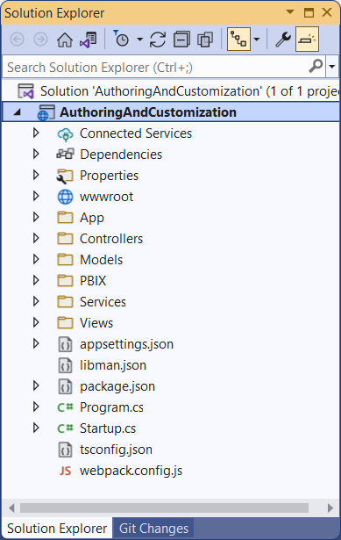
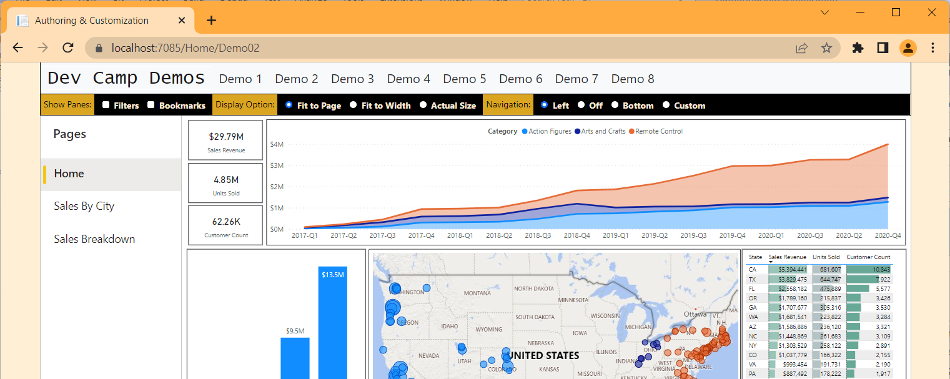
Developer Sample: AuthoringAndCustomization
You can download and try out the sample code used in this webinar
Implemented as C#/.NET6 web application which uses the Power BI .NET SDK
Download from https://github.com/PowerBiDevCamp/PBIE-Authoring-And-Customization
{F5}

Slide 5
Agenda
Initializing and Customizing Report Pages
Creating Custom Navigation with Pages and Bookmarks
Creating Authoring Experiences with the Report Designer
Creating New Pages and Adding Visuals using Code
Embedding Reports using Custom Layouts
Adding Personalization Features using Custom Bookmarks

Slide 6
Power BI JavaScript API (powerbi.js)
Power BI JavaScript API used to embed resources in browser
Client-side JavaScript API required to develop with Power BI embedding
Documentation is titled Power BI embedded analytics Client APIs https://docs.microsoft.com/en-us/javascript/api/overview/powerbi/

Slide 7
Hello World with powerbi.js using TypeScript
You can write code which program powerbi.js using JavaScript or TypeScript
Using TypeScript adds strongly-typed programming and much better IntelliSense
AuthoringAndCustomization project demonstrates programming with TypeScript
TypeScript code in project is compiled into JavaScript using webpack

Slide 8
Viewing Report Object in Chrome Dev Tools

Slide 9
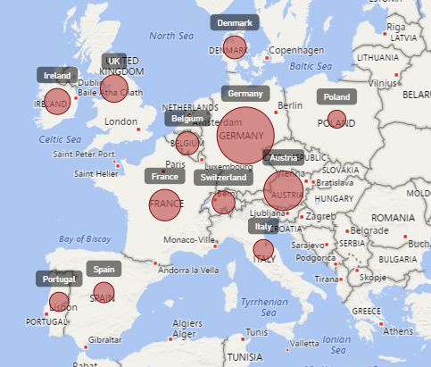
Report Embedding Architecture
Embedding involves creating an iFrame on the page
powerbi.embed transparently generates iFrame and sets source to Power BI Service
The iFrame and hosting page originate from different DNS domains
Web Hosting Server
Your HTML and CSS
https://app1.mydomain.com
Your
JavaScript
iFrame
Embedding Data
Power BI Service
powerbi.js
https://wabi-us-east2-redirect.analysis.windows.net/

Slide 10
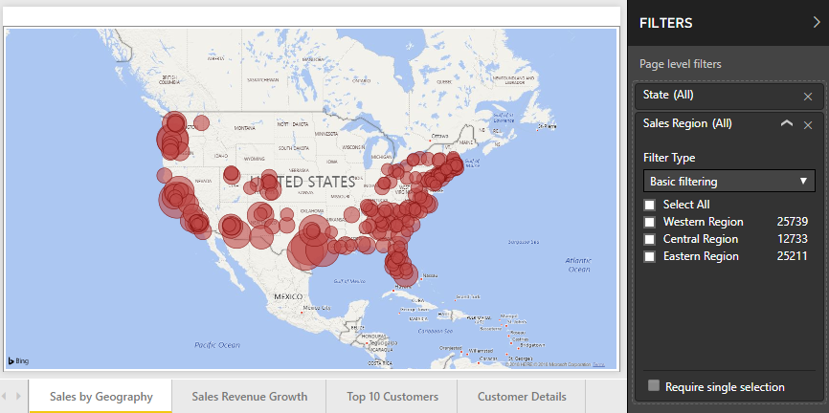
A Promise-based Programming Model
Design of PBIJS simulates HTTP protocol
Creates more intuitive programming model for developers
Programming based on asynchronous requests and promises
Embedded objects programmed using actions and events
Actions
report.fullscreen
report
report.switchMode
report.setFilters
Your
JavaScript
report.getPages
Events
report.loaded
report.pageChanged
report.commandTriggered

Slide 11
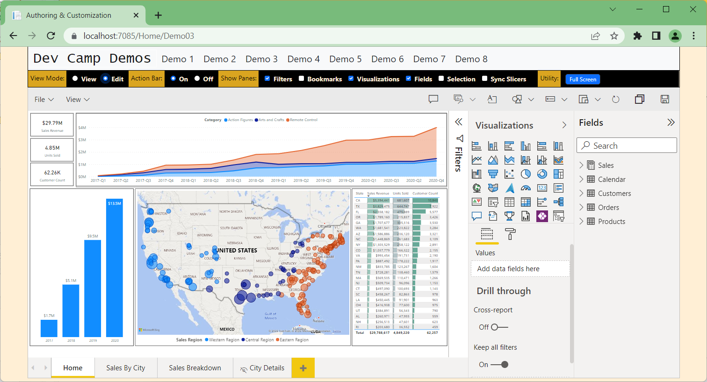
Solution Architecture
xxxx
Power BI REST API
AppOwnsDataAdmin
AppOwnsDataDB
AppOwnsDataClient
AppOwnsDataWebApi

Slide 12
Exploring powerbi.js Events

Slide 13
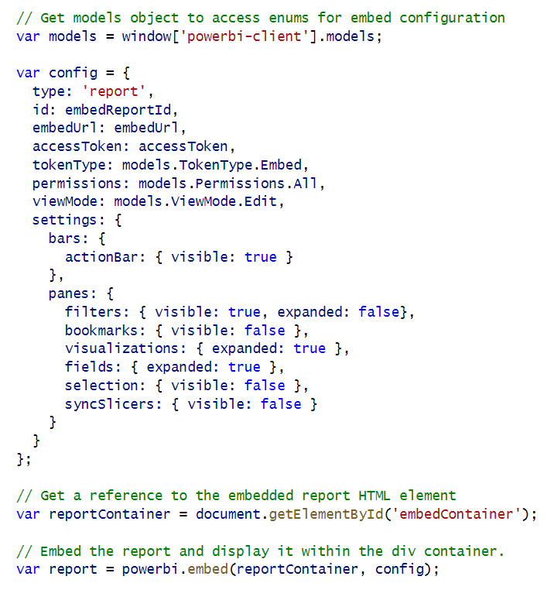
Report Panes

Slide 14
Showing and Hiding Report Panes
Panes in View Mode

Slide 15
Display Option
Display Option can be set to Fit To Page, Fit To Width or Actual Size
Report settings must be updated with a custom layout
Switch report to Fit to Page
Switch report to Fit to Screen
Switch report to Actual size

Slide 16
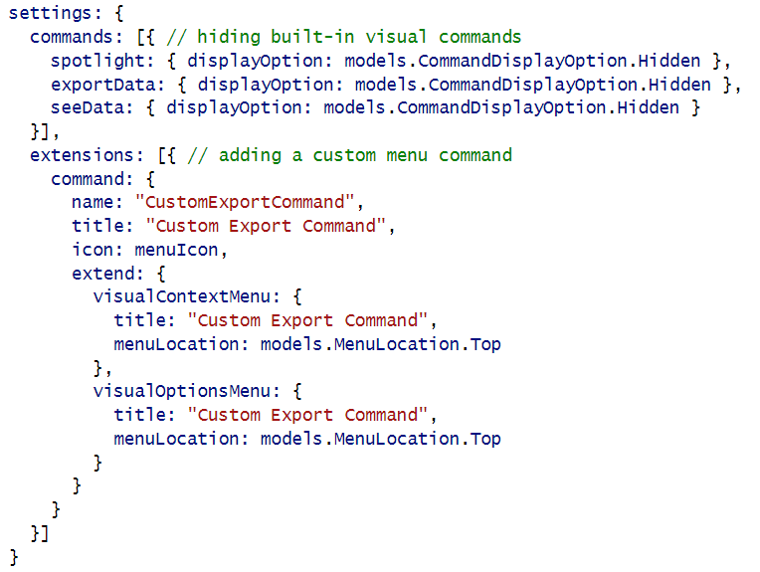
Hiding Built-in Visual Menu Commands

Slide 17
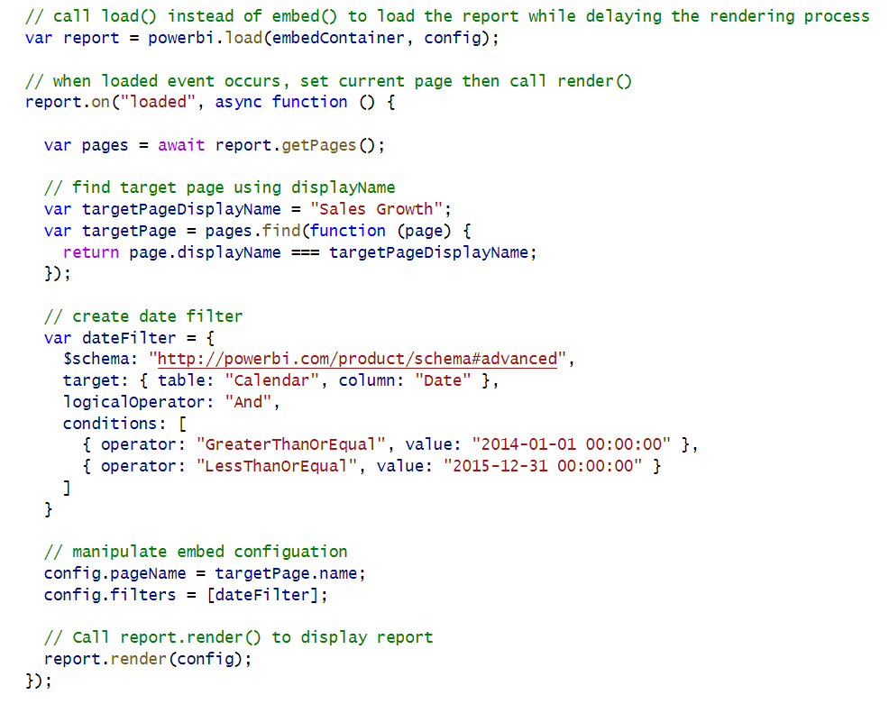
Phased Embedding

Slide 18
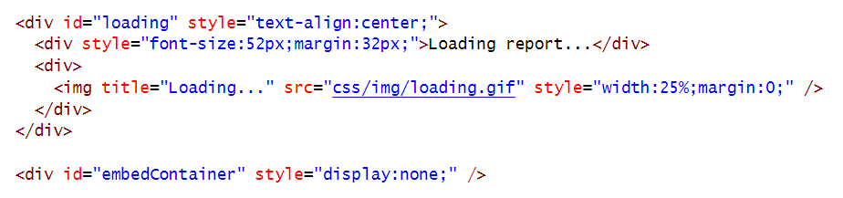
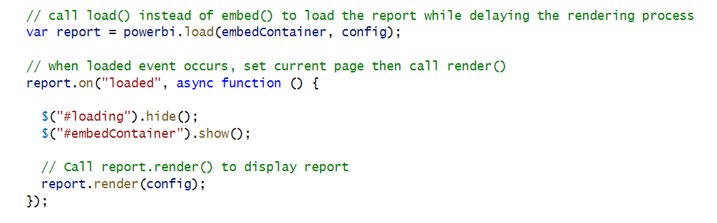
White Label Report Loading

Slide 19
Agenda
Initializing and Customizing Report Pages
Creating Custom Navigation with Pages and Bookmarks
Creating Authoring Experiences with the Report Designer
Creating New Pages and Adding Visuals using Code
Embedding Reports using Custom Layouts
Adding Personalization Features using Custom Bookmarks

Slide 20
Report Navigation Settings

Slide 21
Creating a Custom Navigation Scheme

Slide 22
Agenda
Initializing and Customizing Report Pages
Creating Custom Navigation with Pages and Bookmarks
Creating Authoring Experiences with the Report Designer
Creating New Pages and Adding Visuals using Code
Embedding Reports using Custom Layouts
Adding Personalization Features using Custom Bookmarks

Slide 23
Moving a Report into Edit Mode
Embed token requirements
To save report, ReportId in embed token must have allowEdit set to true
To perform Save As, embed token must have workspace ID

Slide 24
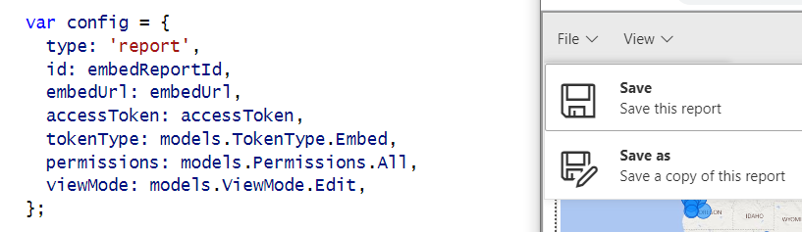
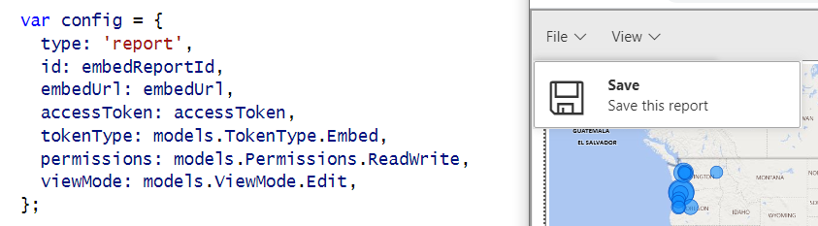
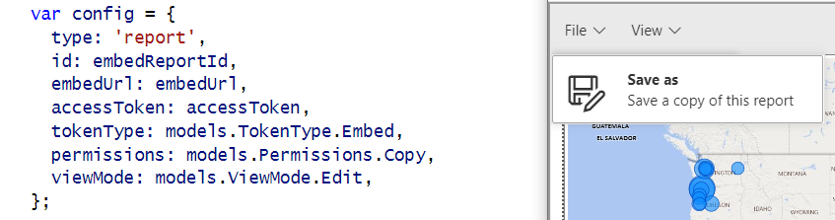
Showing and Hiding the Save and Save as Menus
permissions: models.Permissions.All
permissions: models.Permissions.ReadWrite
permissions: models.Permissions.Copy

Slide 25
Implementing the SaveAs Redirect
saved event fires on both Save and SaveAs actions
Call to Web API to get new embed token with the report ID of the new report

Slide 26
EmbedTokenController Calls GetEmbedToken

Slide 27
Using a Custom SaveAs Dialog

Slide 28
Saving Copy of Report to a Target Workspace

Slide 29
Agenda
Initializing and Customizing Report Pages
Creating Custom Navigation with Pages and Bookmarks
Creating Authoring Experiences with the Report Designer
Creating New Pages and Adding Visuals using Code
Embedding Reports using Custom Layouts
Adding Personalization Features using Custom Bookmarks

Slide 31
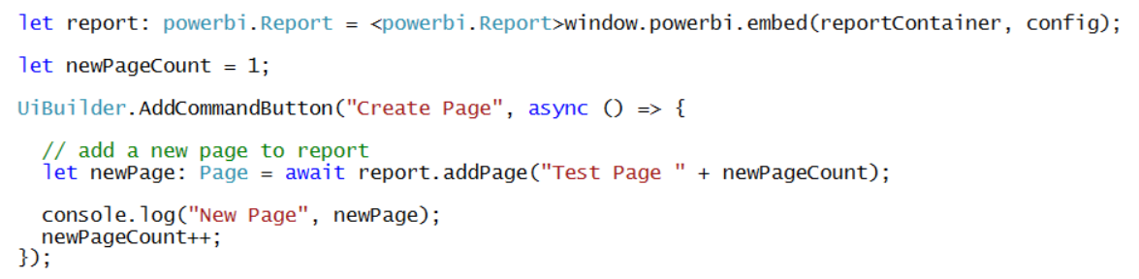
Adding a Page to a Report

Slide 32
Understanding Visual Capabilities

Slide 33
Defining Targets for Columns and Measures

Slide 34
Creating a Table Visual

Slide 35
Create a Column Chart Visual

Slide 36
Create a Map Visual

Slide 37
Visual Types Available for Programmatic Creation
actionButton
areaChart
barChart
basicShape
card
clusteredBarChart
clusteredColumnChart
columnChart
debugVisual
Decomposition Tree
donutChart
esriVisual
filledMap
funnel
gauge
hundredPercentStackedBarChart
hundredPercentStackedColumnChart
image
keyDriversVisual
kpi
lineChart
lineClusteredColumnComboChart
lineStackedColumnComboChart
map
multiRowCard
pieChart
pivotTable
PowerApps
pythonVisual
qnaVisual
ribbonChart
scatterChart
scriptVisual
shapeMap
slicer
stackedAreaChart
tableEx
textbox
treemap
waterfallChart

Slide 38
Agenda
Initializing and Customizing Report Pages
Creating Custom Navigation with Pages and Bookmarks
Creating Authoring Experiences with the Report Designer
Creating New Pages and Adding Visuals using Code
Embedding Reports using Custom Layouts
Adding Personalization Features using Custom Bookmarks

Slide 39
Getting the Names of Pages and Visuals

Slide 40
Creating a Static Custom Layout

Slide 41
Creating a Dynamic Custom Layout

Slide 42
Display a Single Visual

Slide 44
Agenda
Initializing and Customizing Report Pages
Creating Custom Navigation with Pages and Bookmarks
Creating Authoring Experiences with the Report Designer
Creating New Pages and Adding Visuals using Code
Embedding Reports using Custom Layouts
Adding Personalization Features using Custom Bookmarks

Slide 46
Capturing a Custom Bookmark

Slide 47
Working with Persisted Bookmarks

Slide 49
Summary
Initializing and Customizing Report Pages
Creating Custom Navigation with Pages and Bookmarks
Creating Authoring Experiences with the Report Designer
Creating New Pages and Adding Visuals using Code
Embedding Reports using Custom Layouts
Adding Personalization Features using Custom Bookmarks

Slide 50
Microsoft Power BI
Questions?

